Slide 1
Health Monitoring
Presented By Group #1
Ai, Ziqi
Guo Kai
Pielacki Kevin
Shen Hongyuan
Xing Xiang
Yang Guanjiang

Slide 2
Content
Problem
Solution
Outstanding Points
Technical Challenges
Questions

Slide 3
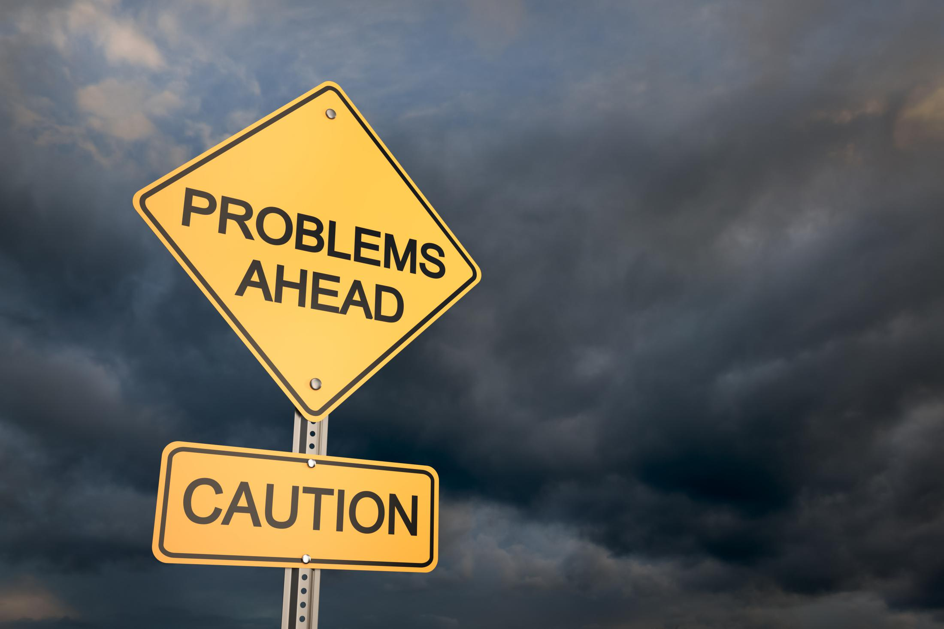
Problem
No centralized system to track general public health
Long term health studies are generally not conducted
New studies have difficulty finding pre-existing data to build from
New health policies are difficult to monitor
Health feedback is limited
Doctor visits can be infrequent
User habits are not tracked
Online research can be tedious
Online information may not apply to a specific person
Notes:
http://www.ece.rutgers.edu/~marsic/Teaching/SE1/report3.html

Slide 4

Solution
Mobile phone app to passively track a user’s health to a web server and provide feedback on the results
Why a Phone App
Carried by Most
Built in Sensors
Feedback is Visible
Why a Web Server
Sharable
Powerful Analysis

Slide 5
Outstanding Points
Fits most of android mobile phones
Combining Map information with real time Hazards to show Health threatens to User
Calorie consumption will be calculated based on user’s activation record of a certain period
A well designed Website to display our data and analysis

Slide 6
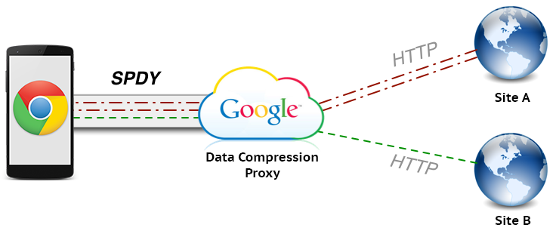
Technical Challenges
Designing the database to work with future data sources
Medical Records
Family History
Future Features
Moving mobile measurements to a remote server
Secure and Reliable Data Transfer
Easy to Adjust
Giving meaningful advice
Updating with New Studies
Reliable User Prediction
Summarized Findings

Slide 7
Questions?
Project Repo: https://bitbucket.org/kpielacki/ece-567
?

